Slide 1
PROJECT 2025

Slide 2
Notes:
Trump made a number of wild promises during the 2016 election.
While he did succeed following through on some of those promises, like passing significant tax cuts for the wealthy, in retrospect, the chaos and infighting within his administration spared us from some of his worst proposals.
A second term will be dramatically different. Not only are the courts skewed in his favor and Republicans more firmly aligned with him, a group of extremists have made sure that he can hit the ground running if he is elected back into office. And even if he is met with resistance from congress or the courts, they have developed ways to go around those institutions.

Slide 3
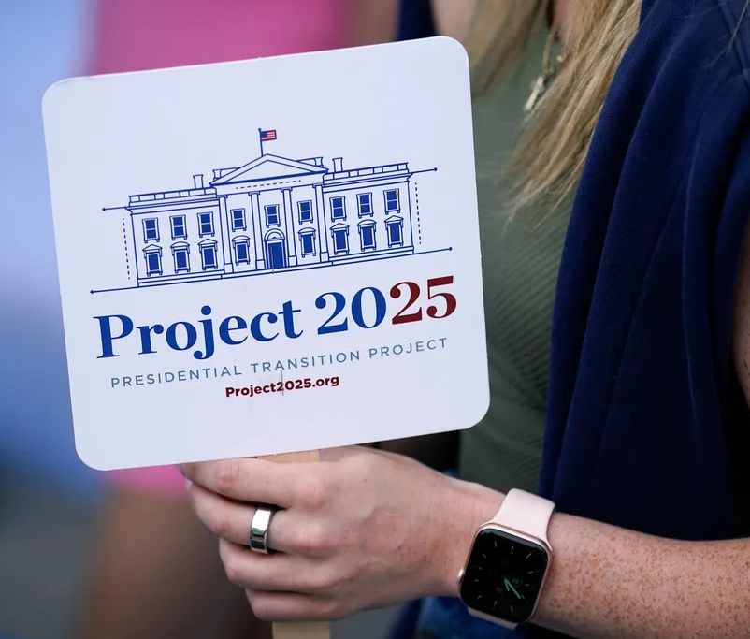
What is Project 2025?
A 920+ page auhtoritarian playbook that serves as a detailed road map for a far-right presidential administration.
It’s policy proposals are sweeping and would affect nearly every facet of American life.
It’s overarching goal is clear: to lay out an blueprint that threatens the rights, freedoms and protections Americans have fouhgt for and won over decades. It would destroy the system of checks and balances our forefathers designed 250 years ago.
.
Notes:
What exactly is Project 2025?
It's an almost thousand page strategic game plan crafted by the right wing extremist touted as a plan to save our country. It’s a presidential transition guide that outlines policies designed to undermine checks and balances across the government and grants more control to extremist politicians, judges, and corporations over the lives of working families. It's been developed in a way so that the next Republican president can do as much as possible without needing authority from Congress.
The policies in Project 2025 impact everyone, but in particular it targets labor. It poses a significant threat to workers' ability to organize unions and negotiate better wages and working conditions.
This $22 million dollar project was written by groups like The Heritage Foundation, ALEC and groups linked to the Koch Brothers. These organizations are known for pushing some of the worst anti-worker legislation at both federal and state levels. ALEC has pushed out model legislation for states to use that prohibit paycheck deductions for dues, introduce automatic decertification, and legalize so-called right to work and union busting among other anti-labor measures.

Slide 4
“This book, this agenda, the entire Project 2025, “is a plan to unite the conservative movement and the American people against elite rule and woke culture warriors.” re a sort of shorthand for a Christian nationalist agenda
https://drive.google.com/file/d/1votuwn1mfLtTG5T7XlcOYWyUwQ7xSqvt/view?usp=drive_link

Slide 5
25 of the 30 chapters were authored by former Trump officials, in full or in part. Authors include Trump’s former Cabinet secretaries; top White House officials and senior aides including former Trump appointees to EPA; the Interior Department and the Federal Regulatory Commission. Moreover, the project is vetting extreme Trump loyalists to stack thousands of federal jobs.
80% of Project 2025’s authors are former Trump administration officials or close advisors and 140 people who worked for former President Trump are involved with Project 2025.
$22 million was spent on this project and funded by groups like (ALEC) American legislative Exchange Council; the Heritage Foundation and groups liked to Koch network.
54 different institutes or foundations are listed as part of the Advisory Board of Project 2025.
300 is the number of times Trump’s name appears in Project 2025.
277 contributors
100 conservative organizations involved in putting Project 2025 together

Slide 6
WHAT IS THE HERITAGE FOUNDATION?
The Heritage Foundation is a non-profit public policy research institute based in Washington, D.C. Founded in 1973, Heritage's mission is to formulate and promote conservative public policies based on the principles of free enterprise, limited government, individual freedom, traditional American values and a strong national defense. With more than 200,000 individual, foundation and corporate supporters, Heritage is the most broadly supported public policy research institute in the country. It has a staff of nearly 200 and an annual budget of $38 million.
HOW ARE THEY FUNDED?
Heritage is a tax-exempt 501(c)(3) organization and BBB Wise Giving Alliance-accredited charity funded by donations from private individuals, corporations, and charitable foundations
WHO RUNS THE FOUNDATION?
Kevin David Roberts (born June 24, 1974) is the president of The Heritage Foundation, a conservative political think tank, and its lobbying arm, Heritage Action. Prior to assuming his current role, he was the CEO of another conservative think tank, the Texas Public Policy Foundation.

Slide 7
BANKING AND MONEY

Slide 8
Project 2025: The Federal Reserve:
According to Project 2025, it would be better to simply abolish the Federal Reserve system altogether and return the U.S. economy to some version of the unmanaged financial rawness of the pre-1913 era. The author of this chapter, Trump administration economist Paul Winfree, writes that the Fed should be replaced by a return to a system of so-called “free banking,” where banks are free to issue their own paper currency (banknotes) and would not be subject to any special regulations beyond those applicable to most enterprises.
It adopts the debatable view that the Great Depression of 1929 was prolonged by the Federal Reserve’s inept management of the money supply. It observes that there has been an economic downturn roughly every five years and blames that on “the impossibility of fine-tuning the money supply in real-time,” a task the Fed is seen as ill-equipped to address.

Slide 9
Under such a system, neither interest rates nor the supply of money would be “controlled by the government.”
In the pre-Fed system, there was no role for a central bank either as a guarantor of money supply or as a “lender of last resort” when the economy is mired in recession or worse.
There was no government insurance for bank deposit accounts, and if a bank struggled with solvency or even failed, its currency would become worthless, and depositors would lose their savings.

Slide 10
Although retirement isn’t a primary focus for Project 2025, the plan calls for “universal savings accounts,” or USAs, with a yearly after-tax contribution limit of $15,000, indexed for inflation.
The tax treatment would be similar to Roth individual retirement accounts, which offer tax-free withdrawals of earnings after age 59½, with some exceptions. By comparison, USAs would be “highly flexible” for investments, and gains could be withdrawn “at any time for any purpose,” according to the plan.

Slide 11
CLIMATE CHANGE

Slide 12
Rescind all climate policies from its foreign aid programs
Cease collaborating with and funding progressive foundations, corporations, international institutions, and NGOs that advocate on behalf of climate action
Repeal the Infrastructure Investment and Jobs Act (IIJA) and Inflation Reduction Act (IRA)
End the EPA’s focus on climate change and green subsidies
Eliminate the Office of Energy Efficiency and Renewable Energy
Eliminate the Clean Energy Corps by revoking funding and eliminating all positions and personnel hired under the program
Direct the Department of Energy to “end the Biden Administration’s unprovoked war on fossil fuels, restore America’s energy independence, oppose eyesore windmills built at taxpayer expense, and respect the right of Americans to buy and drive cars of their own choosing” (page 286)
Stop all federal grants to environmental advocacy groups
Withdraw the U.S. from the U.N. Framework Convention on Climate Change and the Paris Agreement

Slide 13
EDUCATION

Slide 14
Eliminate the Head Start program, restricting access to affordable pre-Kindergarten education. Head Start provides a critical supply of rural childcare.
Aim to eliminate the Department of Education
Advocate for the Secretary of Education to “insist that the department serve parents and American ideals, not advocates whose message is that children can choose their own sex, that America is “systemically racist,” that math itself is racist, and that Martin Luther King, Jr.’s ideal of a colorblind society should be rejected in favor of reinstating a color-conscious society” (page 286)
Not allow a public education employee or contractor to use a name to address a student other than the name listed on a student’s birth certificate or a pronoun in addressing a student that is different from that student’s biological sex, without the written permission of a student’s parents or guardians.
Censor academic discussions about race, gender, and systemic oppression, in violation of the First Amendment, and promising to cut federal funding for schools with curricula that touch on these subjects.

Slide 15
Project 2025’s foreword describes pornography as “manifested today in the omnipresent propagation of transgender ideology” and argues that it “should be outlawed” and people who “distribute it should be imprisoned.” The plan further makes the case that educators and librarians who teach or lend books that fall under this definition of pornography should be registered as “sex offenders.”
Project 2025 pushes for a de facto ban on books and other content that far-right advocates do not like. The plan also appears to argue that sex education would “promote prostitution or provide a funnel effect for abortion facilities and school field trips to clinics.”
Project 2025 urges the next administration to “reject efforts to transform federal school meals into an entitlement program,” effectively banning universal free school meals.

Slide 16
JUSTICE

Slide 17
No longer task FBI agents with monitoring social media to flag content they deemed to be “misinformation” or “disinformation” for platforms to remove
Prevent the FBI from engaging, in general, activities related to Americans creating or spreading misinformation or disinformation
Conduct an immediate, comprehensive review of all major active FBI investigations and activities and terminate any that are unlawful or “contrary to the national interest”
Stop the FBI from devoting “unprecedented resources to prosecuting American citizens for misdemeanor trespassing offenses or violations of the FACE [Freedom of Access to Clinic Entrances] Act”, while dismissing prosecutions against radical agents of the Left like Antifa” (page 546)
Enforce the death penalty

Slide 18
NATIONAL SECURITY

Slide 19
GUTTING AGENCIES
Project 2025 advocates staffing the National Security Council and Situation Room with individuals whose primary qualification is political loyalty. Its proposals would replace nonpartisan career national security officials with partisan operatives.
Project 2025 recommends recalling career foreign service ambassadors serving in the nation’s most consequential postings if they have not demonstrated significant loyalty to the incoming president.
Project 2025 would politicize the military chain of command and U.S. intelligence agencies. It recommends the White House review all senior military general officer and flag officer promotions to ensure they align with domestic political priorities, and to replace career intelligence officers at the Central Intelligence Agency with new hires more committed to the president’s agenda.
Project 2025 recommends that the next administration eliminate the Department of Homeland Security and many of its component offices; eliminate and privatize the Transportation Security Administration; and eliminate the Cybersecurity and Infrastructure Security Agency’s (CISA) (CISA) Cybersecurity Advisory Committee and limit CISA’s ability to support states on election security. Eliminating these agencies would put security of air travel, ports, and rails at risk and would prevent CISA from helping state and local governments and private companies defend against attacks from foreign adversaries

Slide 20
OVERTIME

Slide 21
What Project 2025 says: “Congress should provide flexibility to employers and employees to calculate the overtime period over a longer number of weeks.”
What the research says: Providing employers with less clarity about their wage obligations introduces more opportunities for fraud, abuse, and even honest mistakes. Currently, overtime is calculated weekly, which allows workers to keep track of their time accurately over a shorter time frame and to have more consistent expectations for their schedule. But Project 2025 proposes allowing the employer to choose the time period, giving employees less control of and visibility into their own paychecks
What Project 2025 says: “[Congress should] allow employees in the private sector the ability to choose between receiving time-and-a-half pay or accumulating time-and-a-half paid time off.”
What the research says: The Pew Research Center finds that nearly half of American workers who have access to paid leave from their employment already take less time off from work than they’re eligible for. While stated reasons for this vary, survey respondents noted pressure to not leave their coworkers with more work, concerns about falling behind, and concerns about losing their job. Since access to paid leave is already most limited for the lowest-paid workers, workers who are eligible for overtime are currently less likely to be eligible for paid leave. And notably, lower-wage workers are disproportionately women and Black workers, who Pew finds to be more likely to describe workplace pressure as a reason for taking less leave.

Slide 22
What Project 2025 says: “DOL [the Department of Labor] should maintain an overtime threshold that does not punish businesses in lower-cost regions (e.g., the southeast United States).”
What the research says: Tying wage thresholds to regional variations in what businesses prefer to pay their workers is a long-standing conservative approach that codifies preexisting wage inequality. American workers’ wages have consistently been lowest in the South, originating in slavery. This has only been furthered by sharecropping, the development of a tipping system that shifts the burden of paying wages to customers rather than employers, ongoing discrimination, and low union density.
Jenn Round noted to PolitiFact that Project 2025 could be read as proposing different overtime thresholds in different parts of the country, and it’s not clear how many workers that would affect given that Project 2025 does not include details on which regions would be considered “low cost.” Notably, framing the South, in particular, as “low cost” is misleading; and the Economic Policy Institute debunks the premise of “lower-cost regions” as Project 2025’s justification for lower wages. Adjusting each state’s median annual wages for cost of living, workers in the South are still paid less than other workers.
What Project 2025 says: “The Trump-era threshold is high enough to capture most line workers in lower-cost regions.”
What the research says: The Trump administration’s overtime threshold was only $35,568 a year, or $684 per week. While Project 2025 does not provide a citation for its claim that this amount covers most line workers, analysis of American Community Survey data collected in 2022 shows that slightly less than half of Southern nonmanagerial workers earned below that threshold, excluding self-employed workers, members of the armed forces, and workers under 16. Wages, especially for those earning the least, have been rising at a pace exceeding inflation, indicating that while more recent data are not available, it is likely that the Trump-era threshold—which was not proposed to index to inflation—covers even fewer workers now than it did in 2021 and 2022

Slide 23
1.) Did you work a job that is focused on work and project sprints? Happen to work 70 hours that week to make an arbitrary deadline but then only work 10 hours the next while you wait on another department to get something done? Zero overtime for you.
The plan proposes a 2 or even 4-week overtime horizon where any OT calculated would only come after you work 80 or 160 hours in that time period -- giving employers the flexibility to demand incredible work hours with no extra pay AND removing any incentive for them to effectively plan schedules and work coverage. Also imagine only getting your overtime wages ever month or every other month. What does that mean for your family's budgeting?
2.) Do you have a job where a significant portion of your compensation is based on bonuses, milestones, or commission? Well the Project 2025 plan gives the option for overtime to be calculated exclusively on any base hourly or salary rate. This means that if your employer chooses to change compensation structure to one that is a minimum wage base + bonus/commission, an OT calculations are only based on that minimum wage even if you make $50k/yr.
3.) Project 2025 gives employers the option to offer time and a half equivalent of PTO in lieu of overtime.
On the surface it sounds kind of equitable. Earned time off flexibility instead of wages. However, this turns part of your compensation from something that you control (how you spend your wages), into something that your employer will control (when your PTO is approved). You may bank all the hours you want, but if the employer denied your PTO, it's like denying access to your earned money. If you have PTO rollover limits at work and the employer denies a PTO request around Christmas -- they have stolen that labor from you instead of paying you for it. If you live in a state that doesn't have to pay you out your accrued PTO upon a layoff or leaving a job, then that represents wages stolen from you

Slide 24
PARENTS AND FAMILIES

Slide 25
Repeal non-statutory sexual orientation and gender identity nondiscrimination conditions on agency grants for adoption, restricting the ability for LGBTQ+ families and single parents to adopt and foster children.
Affirms that families “comprised of a married mother, father, and their children are the foundation of a well-ordered nation and healthy society.
Allow child welfare funding to be used for marriage and relationship education
Project 2025 censors academic learning and makes book banning in schools a federal priority. It calls for the criminalization of librarians who allow students to choose banned books.
Project 2025 shifts the tax burden from the wealthy onto the middle class. Under the plan, the typical family of four would see a tax increase of $2,985 per year, while 45,000 households in America reporting more than $10 million in income would each see an average annual tax cut of $1.5 million.

Slide 26
Project 2025 eliminates the U.S. Department of Education, including Title I, which provides funds to ensure schools serving low-income students have additional resources to deliver a high-quality education beyond that which can be supported by local property tax revenue. Ending Title I would lead to the loss of more than 180,000 teaching positions that serve more than 2.8 million students in the United States.
Project 2025 also proposes scrapping the Biden administration’s Title IX revision, which prohibits discrimination based on sexual orientation and gender identity. eliminating Title VII and Title IX of the Civil Rights Act.
Project 2025 censors academic learning and makes book banning in schools a federal priority. It calls for the criminalization of librarians who allow students to choose banned books.

Slide 27
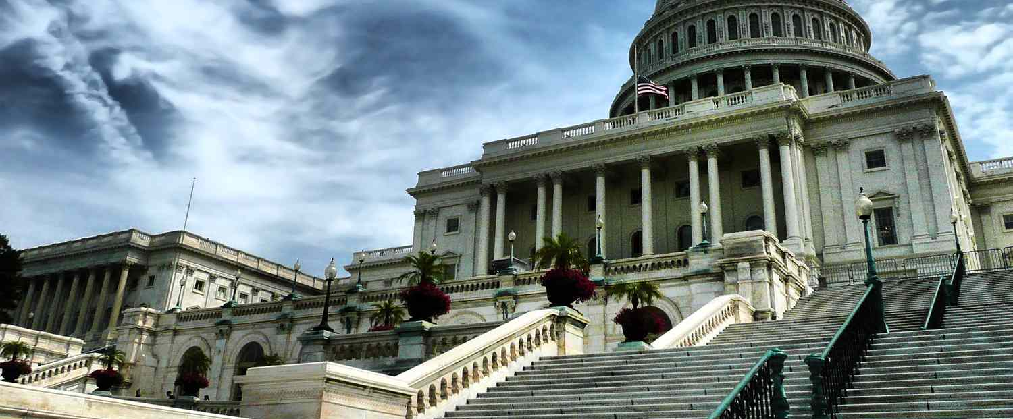
POLITICAL INSTITUTIONS

Slide 28
Attempt to replace all non-confirmed senior members of the State Department with conservative-aligned appointees, appointed by the President-elect’s transition team or the new President’s Office of Presidential Personnel
Encourage the Secretary of State to order a freeze on:
All efforts to implement unratified treaties and international agreements
All allocation of resources and foreign assistance disbursements
All domestic and international contracts and payments
Any uncompleted / ongoing hiring and recruiting decisions
Strip funding from the Corporation for Public Broadcasting, which they call a “liberal forum for public affairs and broadcasting” (page 246)

Slide 29
REPRODUCTIVE RIGHTS

Slide 30
Affirm that abortion is not healthcare.
Project 2025 says the Department of Health and Human Services Department should “return to being known as the Department of Life by explicitly rejecting the notion that abortion is health care.”
Reverse approval of chemical abortion drugs
Restrict access to abortion pills to just 49 days gestation
Prohibit abortion travel funding
Affirm that Congress should pass the Protecting Life and Taxpayers Act, which would accomplish the goal of defunding abortion providers such as Planned Parenthood
Withdraw Medicaid funds for states that require abortion insurance
Audit Hyde Amendment compliance
Undo Obama contraceptive mandate and eliminate the week-after-pill from the contraceptive mandate.

Slide 31
It encourages the next president to implement a backdoor nationwide abortion ban via the Comstock Act, starting with outlawing medication abortion, which accounts for more than 63 percent of abortions in the United States. The plan calls on the Food and Drug Administration to reverse its long-standing approval of mifepristone, one of the two drugs commonly used in medication abortion.
The plan also urges the U.S. Centers for Disease Control and Prevention (CDC) to penalize states that do not submit data on how many abortions take place within their borders, and it recommends that the CDC not promote “abortion as health care” and “misinformation regarding the comparative health and psychological benefits of childbirth versus the health and psychological risks of intentionally taking a human life through abortion.”
It further instructs the U.S. Department of Justice (DOJ) to take legal action against local officials who refuse to bring cases against women and doctors who violate state abortion bans—an escalation for the anti-choice movement, which has traditionally targeted providers, not patients.
Project 2025 urges the next conservative administration to make doctrine law by restoring “religious and moral exemptions to the contraceptive mandate” in the Affordable Care Act, and it wants to remove the morning-after pill ella and male condoms from the contraceptive mandate for insurance coverage.

Slide 32
SENIORS

Slide 33
Loss of No-Cost Vaccines
Project 2025 calls for the Inflation Reduction Act’s repeal. The Inflation Reduction Act (IRA) of 2022 provides a mechanism to protect Medicare beneficiaries from vaccine-preventable diseases by requiring Medicare drug plans—also known as prescription drug, or Part D, plans—to make vaccines recommended by the Advisory Committee on Immunization Practices free for enrollees. Guarantees nearly 54 million Medicare Part D beneficiaries' access to free vaccines
Increasing the cost of prescription drugs
Project 2025’s prescription drug reforms would raise the cost of prescription drugs for up to 18.7 million people on Medicare Part D by eliminating out-of-pocket Medicare drug cost limits. Those beneficiaries could see an average of nearly $400 in lost drug savings in 2025 alone under the Inflation Reduction Act’s redesign of Medicare Part D.
Finally, in what would amount to a huge windfall for Big Pharma, Project 2025 would bar the federal government from negotiating for lower drug prices.

Slide 34
Limiting seniors’ access to health care and putting Medicare’s future at risk
Project 2025 proposes to make Medicare Advantage—privatized Medicare—the “default option” for all Medicare enrollees. Nearly all Medicare Advantage plans require enrollees to obtain prior authorization to receive certain health care services, which gives insurance companies control to interfere with choices made by patients and their doctors and makes it harder for patients to access care. Medicare Advantage plans also can restrict enrollees’ choices of physicians and hospitals.
A stated goal of Project 2025 is to “give beneficiaries direct control of how they spend Medicare dollars.” Yet the result of making MA the default Medicare enrollment option will be the opposite: to give for-profit corporatioins more control by restricting the choices of even more older Americans.

Slide 35
CUTTING ACCESS TO LONG-TERM CARE
Project 2025 proposes capping Medicaid payments to states with no regard for their actual spending needs on health and long-term care.
It also gives states the power to deny coverage of particular services, including long-term services and supports such as home- and community-based care.
According to KFF data, more than 21 million seniors and nonelderly adults with disabilities were enrolled in Medicaid in 2021; this accounted for nearly one-quarter of Medicaid recipients yet more than half of all Medicaid spending.
Additionally, the proposed funding caps could force states to restrict eligibility for long-term services and supports, according to KFF. Alternatively, Medicaid funding caps could force states to outright deny coverage of particular benefits, especially costly services such as long-term care.

Slide 36
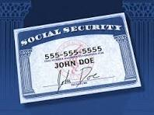
SOCIAL SECURITY

Slide 37
Project 2025 supports raising the retirement age from 67 to 69. All new retirees would see their benefits cut between roughly 12.5 % and 14.3% by the time the increase were fully phased in. A median-wage retiree would lose $46,000 to $100,000 over 10 years, depending on when they claim Social Security.
Project 2025 fails to propose any solutions for Social Security and says, on page 710, that its proposals for the program could not be “covered here in depth.” Notably, that line was co-authored by economist Stephen Moore, who has advocated to slash and privatize Social Security, once calling it a “Ponzi scheme.”
The Social Security trust fund has a projected depletion date in 2035, the annual trustees’ report showed in May. This could result in a benefit cut of at least 20% by that date without action from Congress.

Slide 38
TAX REFORM AND TAXES ON
THE MIDDLE CLASS

Slide 39
PROJECT 2025 TAX REFORM PLAN:
Enact a two-income tax bracket system that would raise taxes by $3,000 for the median family of four—which makes about $110,000 a year—and raise taxes by $950 for the typical single-person household, which makes about $40,000 a year. (see Appendix for state-specific data)
Provide an average $1.5–2.4 million tax cut for the 45,000 U.S. households making more than $10 million annually from the combination of the “two-bracket” system and cuts to taxes on the wealthy’s investment income.
Cut the corporate tax rate to 18 percent, which amounts to a $24 billion tax cut for the Fortune 100.
Replace all individual and corporate income taxes with a consumption tax in the long term. This could take the form of a value-added tax well above 45 percent, which would produce an enormous one-time burst of inflation and raise prices. The shift toward a flat consumption tax while eliminating income taxes would lead to an average $5,900 tax increase for the middle 20 percent of households and an average $2 million tax cut for the top 0.1 percent.
Project 2025 also “eliminates most deductions, credits and exclusions”but is unknown which ones would be eliminated. If Project 2025 were to eliminate the child tax credit and earned income tax credit, the tax increases on low- and middle-income families would be even larger

Slide 40
Project 2025’s immediate tax reform is a $3,000 tax increase for the typical family of four
The centerpiece of Project 2025’s “intermediate tax reform” plan consolidates seven individual income tax brackets, ranging from 10 to 37 percent, to just two brackets: 15 percent and 30 percent.
Project 2025 says this is a way to “to simplify the tax code,” but the number of tax brackets is already one of the simplest parts of the tax code, especially since tax-filing software instantly calculates how much tax families owe for income in each bracket.
Moreover, 70 percent of tax filers only have enough income to be in the first two brackets, so they effectively are already in a two-bracket system.

Slide 41
PROJECT 2025’S IMMEDIATE TAX PLAN IS A LARGE CORPORATE TAX CUT
Project 2025 does not stop at cutting taxes for wealthy individuals; it also proposes an array of tax cuts for corporations. This starts by doubling down on the staggering 14 percentage-point cut in the corporate tax rate that the majority of congressional Republicans enacted in 2017 by further cutting the rate from 21 percent to 18 percent. This would amount to a $24 billion tax cut for the Fortune 100, the 100 largest companies in America, based on CAP analysis of their latest financial statements.
This includes:
A $1.3 billion tax cut to the five largest U.S. oil companies: Exxon Mobil, Chevron, Marathon Petroleum/ConocoPhillips, Phillips 66, and Valero Energy
A $1.6 billion tax cut to the five largest drug makers: Johnson & Johnson, Merck, Pfizer, AbbVie, and Bristol Myers Squibb
A $2.1 billion tax cut to the five largest Wall Street banks: JPMorgan Chase, Bank of America, Citigroup, Wells Fargo, and Goldman Sachs
A $800 million tax cut to the five largest grocery companies: Kroger, Costco, Albertsons, Target, and Walmart
Project 2025 would further cut taxes for corporations by repealing the Inflation Reduction Act’s tax increases for corporations, including a 15 percent minimum corporate tax rate for the largest corporations and an excise tax on stock buyback.

Slide 42
WORKERS AND UNIONS

Slide 43
Project 2025 calls for cutting the U.S. Department of Labor’s (DOL) budget and focusing health and safety inspections on only certain offenders, “as other inspections are often abused and usurp state and local government prerogatives.” Other agencies caught i its crosshairs is the National Labor Relations Board, the Equal Employment Opportunity Commission and the Pension Benefit Guaranty Corporation.
The plan urges Congress and the DOL to exempt small-business, first-time, and nonwillful violators from being subject to Occupational Safety and Health Administration fines.
Project 2025 would get rid of public sector unions entirely and erode—if not eliminate—collective bargaining rights.
The plan’s authors also argue that the U.S. Federal Railroad Administration’s Notice of Proposed Rulemaking establishing a minimum two-person rail crew in most circumstances is not actually based on safety considerations and should be changed back to requiring only one person. The big rail companies claim that giant freight trains—some of which can be 3 miles long—can be safely operated by one person, and Project 2025 authors support this position. Single-person freight train crews risk the safety of conductors, engineers, and the communities along rail lines.

Slide 44
ENDANGERING WORKPLACE SAFETY AND CHILD LABOR MEASURES:
. It also recommends that the DOL amend its hazard-order regulations to allow teenage workers to work “dangerous jobs” in “dangerous fields.”
UNDERMINING THE RIGHT TO ORGANIZE AND COLLECTIVELY BARGAIN:
Project 2025 proposes a ban on “card check,” one of the main ways workers can organize a union and bargain collectively for better wages, benefits, and working conditions. The proposal also weakens the National Labor Relations Board’s watchdog role, which would make it harder to form a union and have that union recognized. Furthermore, the plan urges a ban on public-employee unions and allows states to ban unions entirely. According to the AFL-CIO, the plan also “make[s] it easier for employers to get rid of workers’ unions in the middle of … contracts.” Unions, of course, play a critical role in helping lift workers’ wages and growing the middle class. Finally, Project 2025 seeks to replace unions’ high-quality training and apprenticeship programs with lower-quality and likely substandard training programs designed to benefit corporations and pad their bottom lines
Project 2025 recommends that the National Labor Relations Board eliminate the contract bar rule so that employees can more easily decertify their union and states that “Congress should discard ‘card check’ as the basis of union recognition and mandate the secret ballot exclusively.”
MAKING IT EASIER FOR EMPLOYERS TO DISCRIMINATE:
Project 2025 sabotages the Equal Employment Opportunity Commission, making it more difficult to track violations of the Civil Rights Act’s Title VII protections. Doing so would enable employers to more easily discriminate against people based on their identities. People of color, women, those with disabilities, and those who identify as LGBTQI+ would be disproportionately affected.

Slide 45
GUTTING RURAL CONNECTIVITY:
Project 2025 calls for repealing all unspent funds provided through the Infrastructure Investment and Jobs Act, otherwise known as the bipartisan infrastructure law (BIL).
Rural communities have benefited tremendously from the law, including through upgraded roads, bridges, tunnels, airports, ports, and waterways.
The BIL also provided an unprecedented $65 billion to deploy broadband in all communities and make internet access more affordable. Prior to the law’s passage, rural communities were nearly 15 times more likely to lack access to reliable broadband than those in urban areas. Repealing the bipartisan infrastructure law’s broadband investments would disproportionately harm people living, working, or going to school in rural America

Slide 46
IMPACT ON ABILITY TO ORGANIZE AND LABOR RIGHTS:
Enabling misclassification of employees as independent contractors–eliminating their labor protections altogether (p. 591)
Allowing management-run fake unions like the one T-Mobile set up when workers there were organizing to form a union with CWA (p. 599)
Banning majority sign-up as a way for workers to form unions (p. 603)
Repealing all prevailing wage laws (p. 604)
Rescinding guarantees for mandatory overtime pay when working over 40 hours in a week (p. 592)
Eliminating merit staffing protections for state employees (p. 605)
Abolishing public sector unions (p. 82) and removing civil service protections for tens of thousands of federal employees, so that Trump can replace them with ideological allies willing to carry out his personal agenda (p. 80)
Ending broadband policies that include the first ever labor rights protections on federal broadband funding to create good union jobs (p. 855)

Slide 47
OTHER THREATS TO WORKERS:
Cutting Trade Adjustment Assistance, a program available to workers whose jobs are shipped overseas (p. 806)
Encourages termination of struggling pension plans (p. 643)
Allowing teenage workers access to work in dangerous occupations, including mines and meatpacking plants (p. 595)
Making it easier for employers to discriminate based on a worker’s race, gender, gender identity and sexual orientation (p. 583 and p. 584)
Making it easier for airlines based in tax havens or countries without labor protections to secure licenses to operate in the U.S. market (p. 631)
Project 2025 demands that federal agencies prohibit the use of any racial classifications or quotas related to the workplace, and also prohibit even the collection of employment statistics based on race/ethnicity.

Slide 48
VETERANS

Slide 49
20
DEPARTMENT OF
VETERANS AFFAIRS
Brooks D. Tucker
MISSION STATEMENT
The Department of Veterans Affairs (VA) is the primary provider of health care, benefits, and memorial affairs for America’s veterans and their families. The VA has the noble responsibility to render exceptional and timely support and services with respect, compassion, and competence. The veteran is at the forefront of every VA process and interaction. The VA must continually strive to be recognized as a “best in class,” “Veteran-centric”1 system with an organizational ethos inspired by and accountable to the needs and problems of veterans, not subservient to the parochial preferences of a bureaucracy.
OVERVIEW
At the end of the Obama Administration, the VA was held in low esteem both by the veterans it served and by the employees who served these former warriors. Eroding morale caused by the downstream effects of a health care access crisis in 2014 led to the resignation of Secretary Eric Shinseki and extensive oversight investigations by Congress from 2015–2016.
By 2020, however, the VA had become one of the most respected U.S. agencies. This significant progress was due in part to the leadership of Secretary Robert Wilkie (2018–2021) and his team of political appointees and career senior executives, many of them veterans, who led the effort to ensure that the VA became “Veteran-centric” in its governance decisions and fostered a more positive work environment.
This mindset translated into a department that was better attuned to employees’ and veterans’ needs and experiences in the daily operations of health care, benefits, and memorial affairs.
Pages 641 - 655

Slide 50
CUT HEALTH COVERAGE FOR VETERANS AND REDUCE QUALITY OF CARE
The Veterans Health Administration provides health insurance to many veterans, many younger than 65 are enrolled in Medicaid.
Roughly 1 in 10 service members rely on Medicaid for health care coverage, with 2 in 5 relying on Medicaid exclusively.
Project 2025 proposes capping Medicaid payments to states with no regard for their actual spending needs on health and long-term care and giving states the power to deny coverage of particular services, including long-term services and supports such as home- and community-based care. The proposed funding caps could force states to restrict eligibility for certain types of services and supports currently provided through Medicaid. Alternatively, Medicaid funding caps could force states to deny coverage of particular benefits, especially costly services such as long-term care.

Slide 51
MAKES IT EASIER FOR SCAMMERS TO PREY ON VETERANS
Project 2025 proposes to abolish the Consumer Financial Protection Bureau (CFPB), which plays a critical role in protecting veterans from financial fraud and scams.
REDUCE MEDICAL CONDITIONS
Project 2025 proposes making it harder for veterans to obtain disability benefits by reducing the number of medical conditions that service members can claim to qualify for disabled status.
INCREASE PATIENT VISITS
A separate Project 2025 proposal to force VA hospitals to “increase the number of patients seen each day to equal the number seen by DoD medical facilities” would significantly undermine the quality of care.

Slide 52
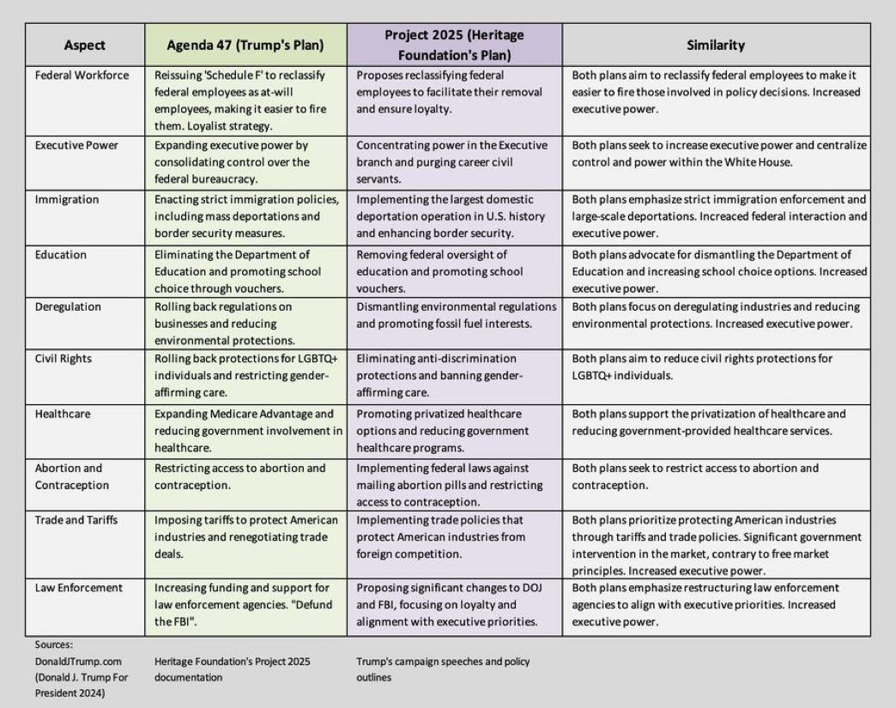

Slide 53
Americans should dread any demagogic movement — from the left or the right.
Indeed, American citizens should remain vigilant against any effort to design political systems, policies, enactments or actions around the cult of personality. I
In practical terms, we should reject any attempt to lionize the likes of Joe Biden or Donald Trump, Barack Obama or Ronald Reagan.
It’s about the institutions in America; it’s always been about the institutions. America’s system of separate powers, checks and balances, bicameralism, federalism, and the like works only if formal political power is distributed — not concentrated — and political branches — not individuals or parties — maintain their institutional integrity.
Effective government has always required institutional collaboration.

Slide 54
“We are writing a battle plan and marshalling our forces”
No area of American life is left untouched.
https://youtu.be/I1kqPJC4lgo?si=PVrKLhSL-lj3Z8Uo
Notes:
If you might be thinking “We survived trump's first term, we will be fine the second time around.” First off, not everyone did. And secondly, hopefully it is clear by now that Trump’s second term will be much much worse. If you think of his first term as chaos, his second will be ruthless efficiency. There is a plan in place to enact an anti-worker agenda on day one.
Even if Trump loses, the people who wrote Project 2025, will move on with implementing their anti-worker agenda, whether through Project 2029 in four years, the courts or state and local governments. They are building capacity and organizing NOW.
So it is time for us to get serious. We need to make sure our voices are louder than their bad ideas. This is about power and if we have any shot of counteracting them, it will require our collective work.
As we always say “True political power comes from an organized working class fighting for justice!”
I hope you will join us, get engaged, and make a difference this election cycle because everything is at stake.

